Slide 1
Exam 3 Presentation
Team Avengers:
Aitemir Yeskenov, Nagarjuna Kanneganti , Sai Suraj Argula, Vinay Kumar Reddy Baradi

Slide 2
Requirements described
Use the email notification for this assignment:
What are the customer and the vendor user stories here?
What are the entities and attributes underlying this user story?
Describe the ML/AI system, process and value result in this example.
Which parts of this scenario are descriptive, predictive, prescriptive?
Build a data model that supports this scenario with: schemas, tables, columns, constraints (checks, defaults, rules, triggers), UDFs and SPROCs.

Slide 3
Business Process Supported
For this assignment, we decided to build a simplified version of an online store that is mainly focused on selling motor oil. We created basic entities such as Employee, Customer, Product, Order, Zip_state in order to demonstrate how a store can run analysis of the data that it is storing and pushes the notifications to the most active users.

Slide 4
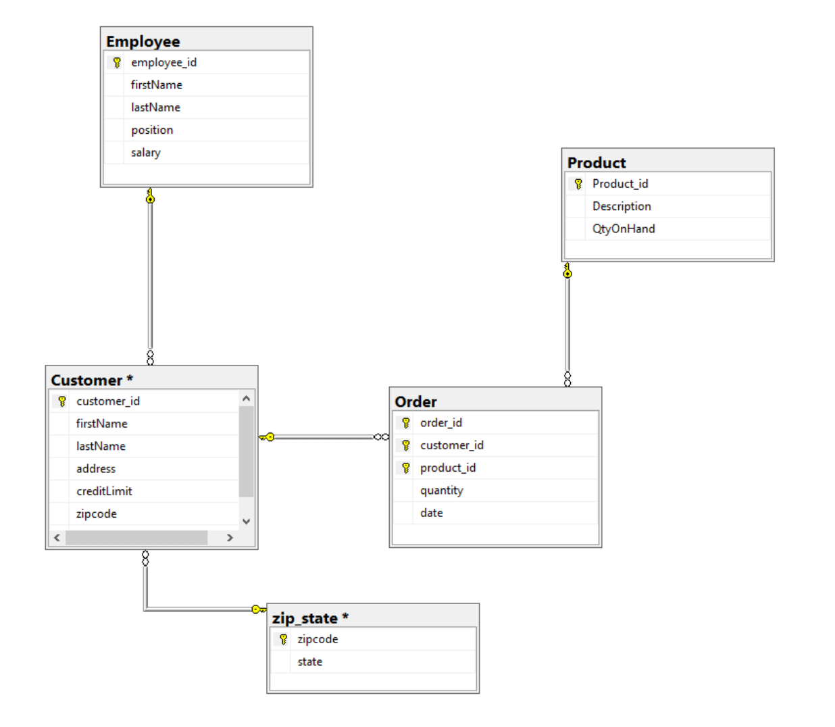
Database Diagram

Slide 5
Customer User Story
Customer purchases motor oil online on a regular basis. Customer wants to receive an email notification with promotions / discounts based on their purchase history.

Slide 6
Vendor User Story
The online store employees want to generate email notifications with promotions based on customers’ purchase history and send them to frequent customers from Florida on daily basis.
Note: the employees ask data analysts to write down requirements based on the customer data and write necessary queries to pick customers that are eligible for promotions.

Slide 7
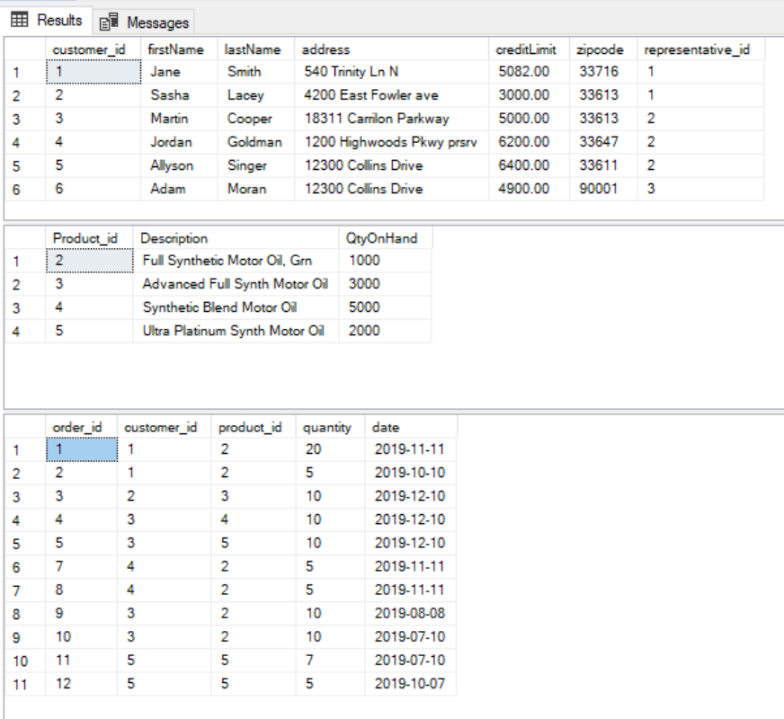
Dataset Overview
1) Customer 3) Order
2) Product

Slide 8
Dataset Overview (continued)
Customer data has some important attributes such as credit limit and zip code that play a big role in data analysis.

Slide 9
Database Diagram - Customer and Zip_state

Slide 10
Promotions Eligibility Criteria
Customer who purchased 3 items per order at least once throughout last month
Customer who placed an order at least more than one once
Customer who lives in Florida
Customer whose credit limit either equals or exceeds $3,500

Slide 11
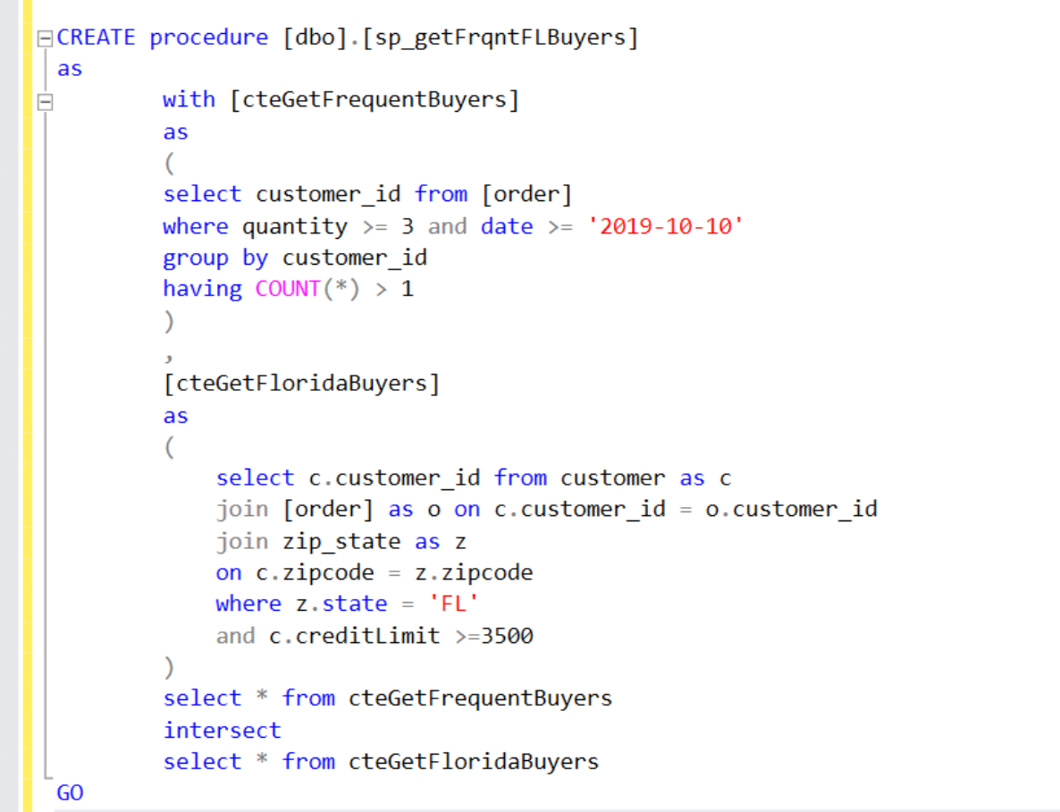
Technical Implementation – SPROC with 2 CTES
Customer who purchased 3 items per order at least once throughout last month
Customer who placed an order at least more than one once
Customer who lives in Florida
Customer whose credit limit either equals or exceeds $3,500

Slide 12
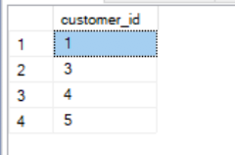
Output Sample
Order table: Qualified Customers:

Slide 13
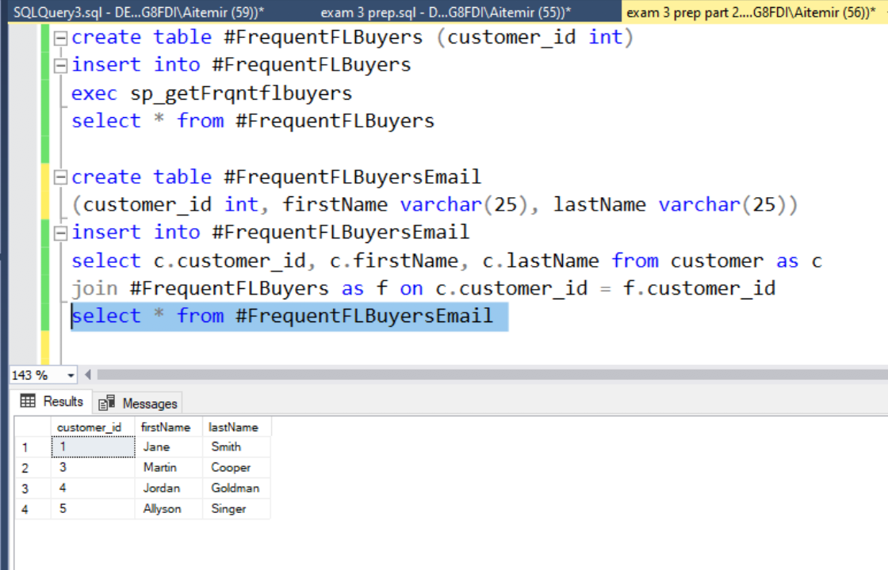
Email Notification Generation
Execute the stored proc and populate temporary table
Get full name of the customer based on the customer ids from the temporary table

Slide 14
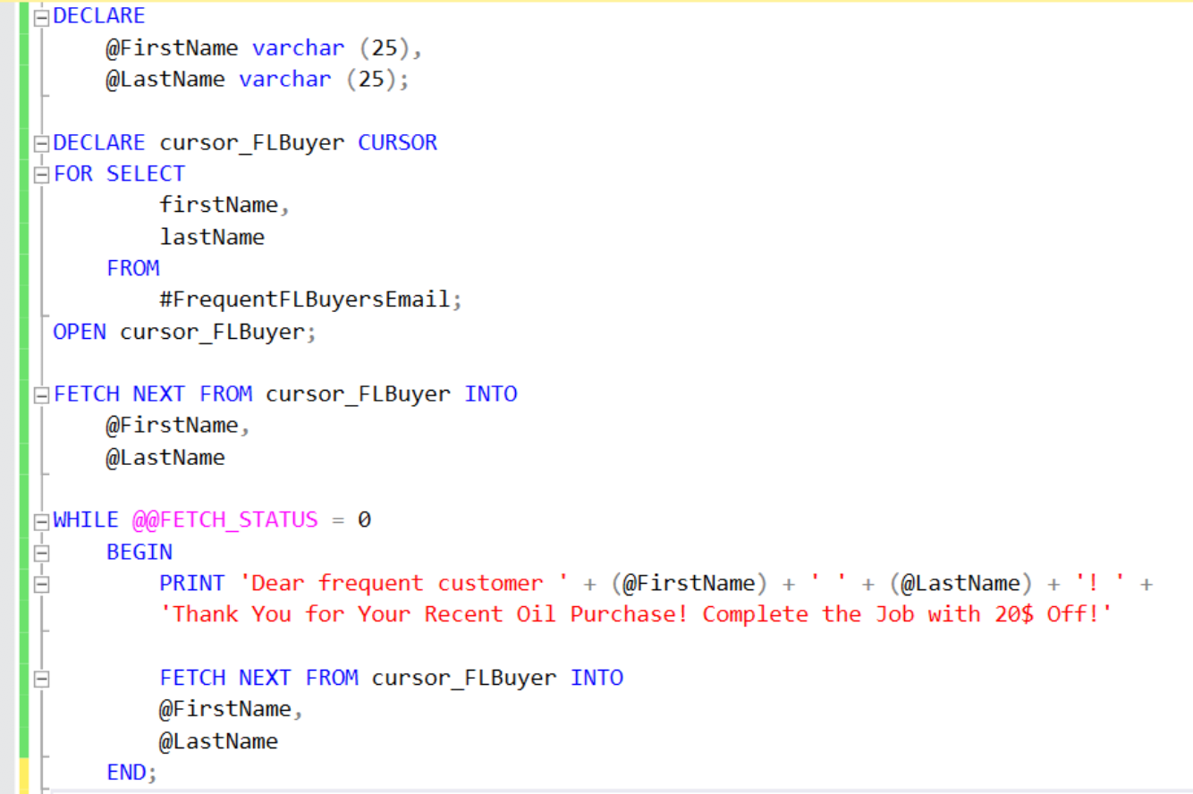
Email Notification Generation - Cursor
We wrote a cursor to generate a sample notification for the purpose of testing
The cursor loops through each of the record and prints a message for each individual customer

Slide 15
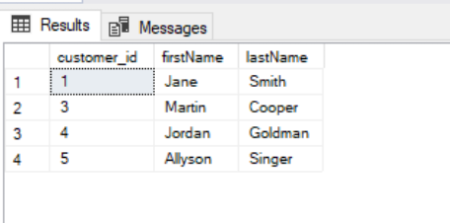
Messages Generated From Cursor
List of eligible customers:
Messages generated through the cursor:

Slide 16
Types of Analytics
Descriptive – prepared and analyzed historical data from tables “Order” and ”Customer” in the CTEs
Predictive – found relationship in data that is not apparent with descriptive analysis (credit limit of a person living in Florida)
Prescriptive – the sp_getFrqntFLBuyers SPROC is designed to target only frequent customers from Florida

Slide 17
Real World Example
After testing with the cursor, the DBA should start a job running every day at 12pm
The result set with the returned customer IDs from the SPROC should be sent to the email notification web-service
The web-service should send the emails to all the customers retrieved from the output of the SPROC
The customers then should be able to receive the notifications

Slide 18
Real Life Example Workflow
Customer IDs of the frequent customers
Email Notification Web-Service
Customers emails

